Slide 1
Combating Deadlock in RDMA Data Center Networks

Slide 2
Problem Background

Slide 3
Advantages of RDMA Data Center Networks
Ultra-low latency
High throughput
Very low CPU overhead

Slide 4
RDMA is Not Robust by Itself
Priority Flow Control (PFC) is key for providing a lossless L2 network as PFC pause frames can always prevent packet loss in time under normal circumstance.
PFC is not for free because it can create deadlock
Routing loop can cause PFC deadlock.
Cyclic routing dependency can cause PFC deadlock.
Device bugs can cause PFC deadlock.

Slide 5
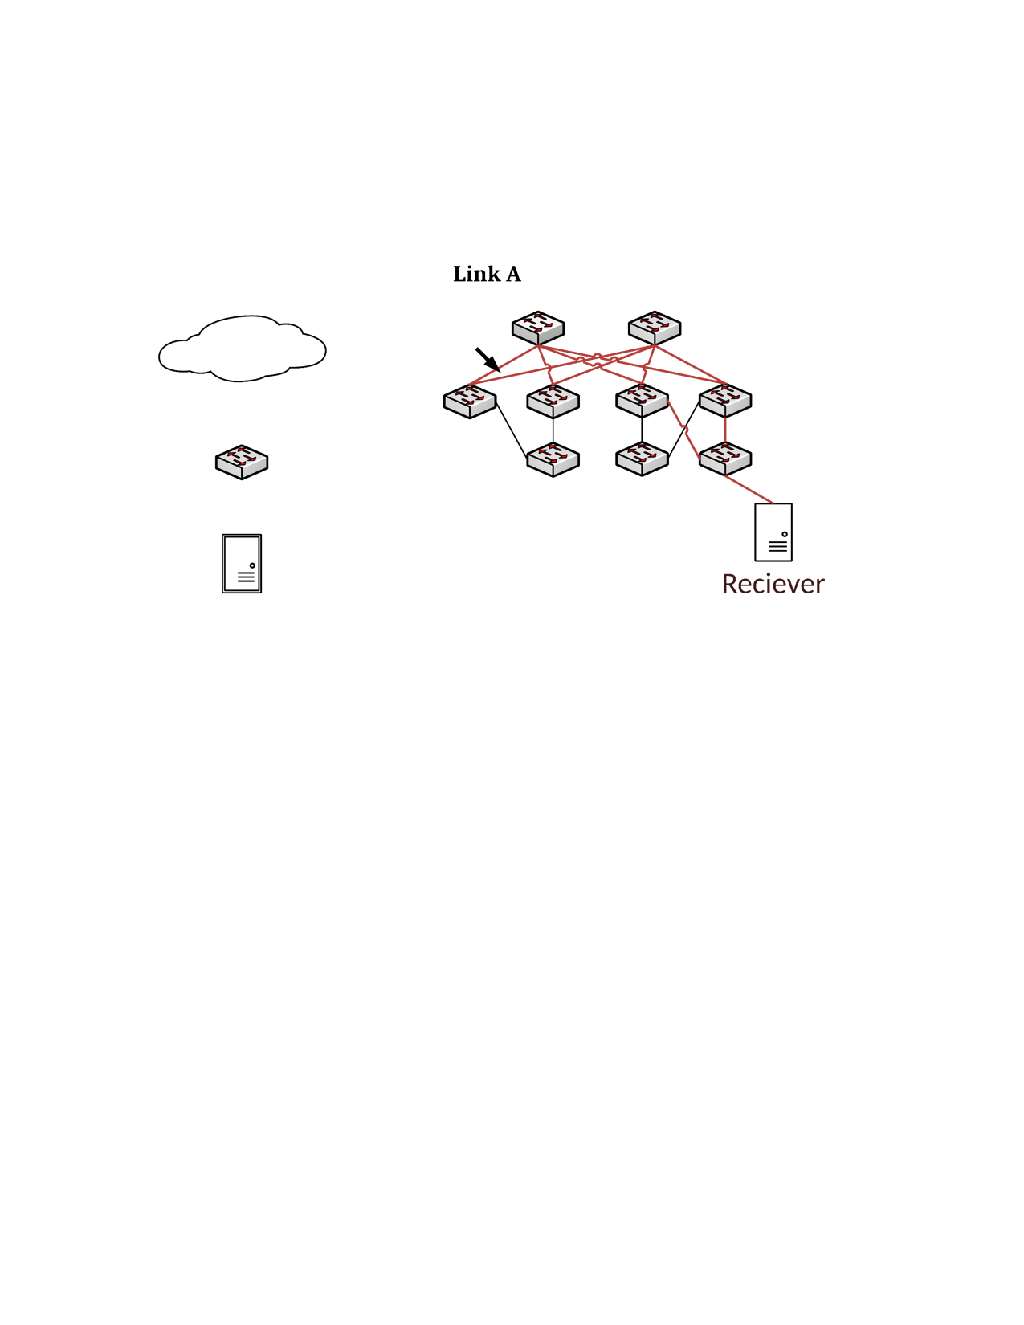

Loop-Induced Deadlock Case in Clos
Core 1
Core 2
10.0.0.0/16 -> Aggr 1,2
10.1.0.0/16 -> Aggr 3,4
10.1.0.0/24 -> ToR 3
10.1.1.0/24 -> ToR 4
Default -> Core 1,2
Aggr 1
Aggr 2
Aggr 3
Aggr 4
ToR 1
ToR 2
ToR 3
ToR 4
H1: 10.0.0.1
H2: 10.1.1.1
Notes:
Play the slide to view the animations.
1. H1 is sending traffic to H2.
2. Switch ToR4 fails, and the route “10.1.1.0/24 -> ToR 4” is removed from the forwarding tables of switch Aggr 3 and Aggr 4.
3. 1) Traffic is forwarded to Core 2 from Aggr 3 by default route;
2) traffic is forwarded to Aggr4 from Core 2;
3) traffic is forwarded to Core 1 rom Aggr 4.
4) traffic is forwarded to back to Aggr3.
5) A routing loop occurs and soon a deadlock will be created.

Slide 6
Cyclic Routing Induced Deadlock Case in Clos
Core 1
Core 2
Aggr 1
Aggr 2
Aggr 3
Aggr 4
Flow 1
ToR 1
Flow 3
ToR 2
ToR 3
Flow 2
ToR 4
H1: 10.0.0.1
H2: 10.0.1.1
H3: 10.1.0.1
H4: 10.1.1.1
Notes:
Two Links Aggr2-ToR2 and Aggr3-ToR4 is under repair. Flow 1 and Flow 2 are rerouted to two non-shortest paths. Then a cyclic routing dependency is created.

Slide 7
Cyclic Routing Induced Deadlock Case in Clos
Flow 3
Aggr2
Core1
Flow 1
tx
rx
rx
tx
tx-1
rx
Core2
Aggr3
Flow 2
tx-2
rx
tx

Slide 8
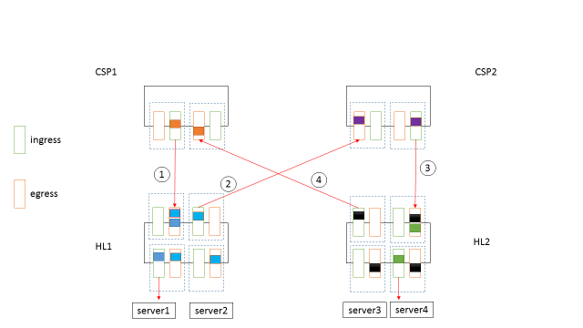
Device Bug Induced Deadlock Case
In one of our production RDMA data center, A deadlock is caused by packet flooding bug of Arista Switch (details are omitted here).

Slide 9
Analysis of Loop-Induced Deadlock

Slide 10
Loop-Induced Deadlock - Routing loop $≠$ Deadlock
Inject Lossless traffic into a 2-hop routing loop:
L1
L2
TTL =16, Link capacity = 40Gbps:
172.16.4.0/31 -> T2
Injection rate | Deadlock
4Gbps | No
5Gbps | No
6Gbps | Yes
172.16.4.5/32 -> L2
T1
T2
H1: 172.16.3.6
H2: 172.16.4.5
Routing loop is just a necessary condition because TTL expiration of packets will prevent packets from building up in the loop.

Slide 11
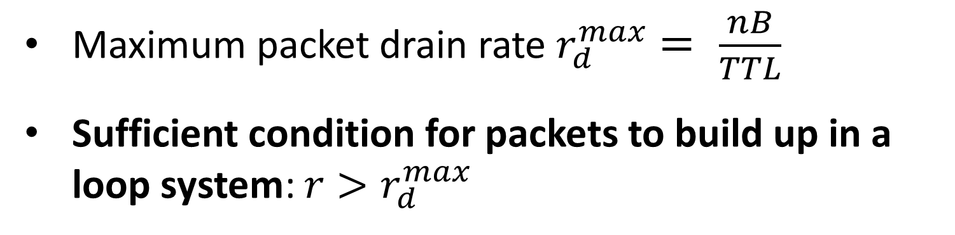
Loop-Induced Deadlock – Impact of TTL Expiration
r | Inject rate of new packets.
B | Link bandwidth.
r_{d} | Packets drain rate caused by TTL expiration.
TTL | TTL value.
n | Hop number of the routing loop.
r
B - r_{d}
qn
q1
…
Maximum packet drain rate $r_{d}^{max}= \frac{nB}{TTL}$
Sufficient condition for packets to build up in a loop system: $r>r_{d}^{max}$
B
q2
Basic Model

Slide 12
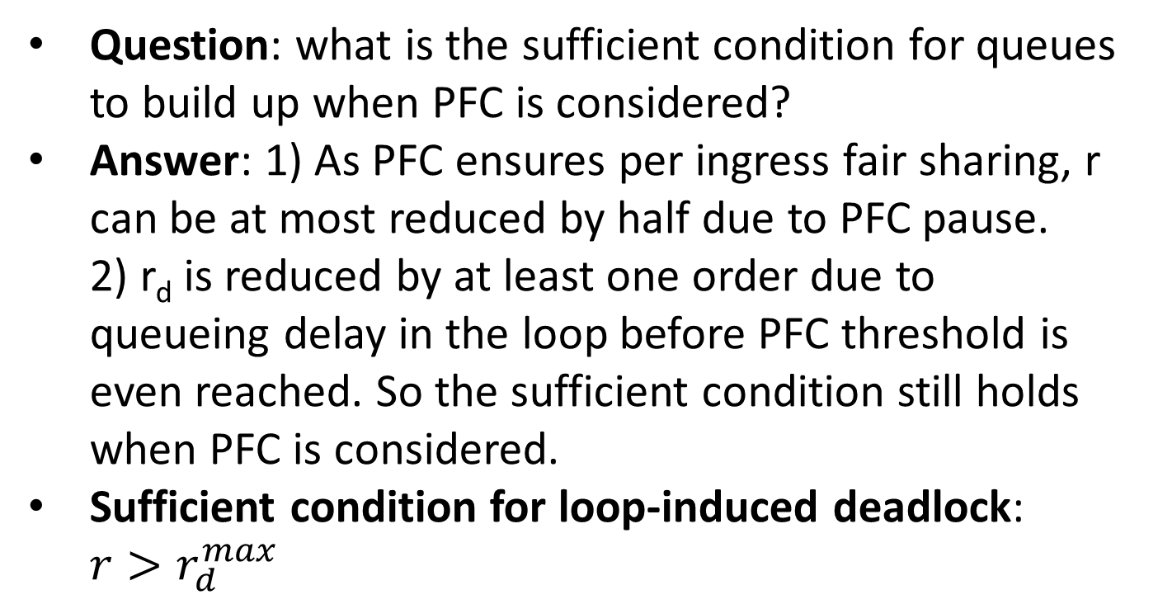
Loop-Induced Deadlock - Consider PFC
r
B - r_{d}
Question: what is the sufficient condition for queues to build up when PFC is considered?
Answer: 1) As PFC ensures per ingress fair sharing, r can be at most reduced by half due to PFC pause. 2) r_{d} is reduced by at least one order due to queueing delay in the loop before PFC threshold is even reached. So the sufficient condition still holds when PFC is considered.
Sufficient condition for loop-induced deadlock: $r>r_{d}^{max}$
qn
t_{PFC}
q1
…
B
q2
Consider PFC

Slide 13
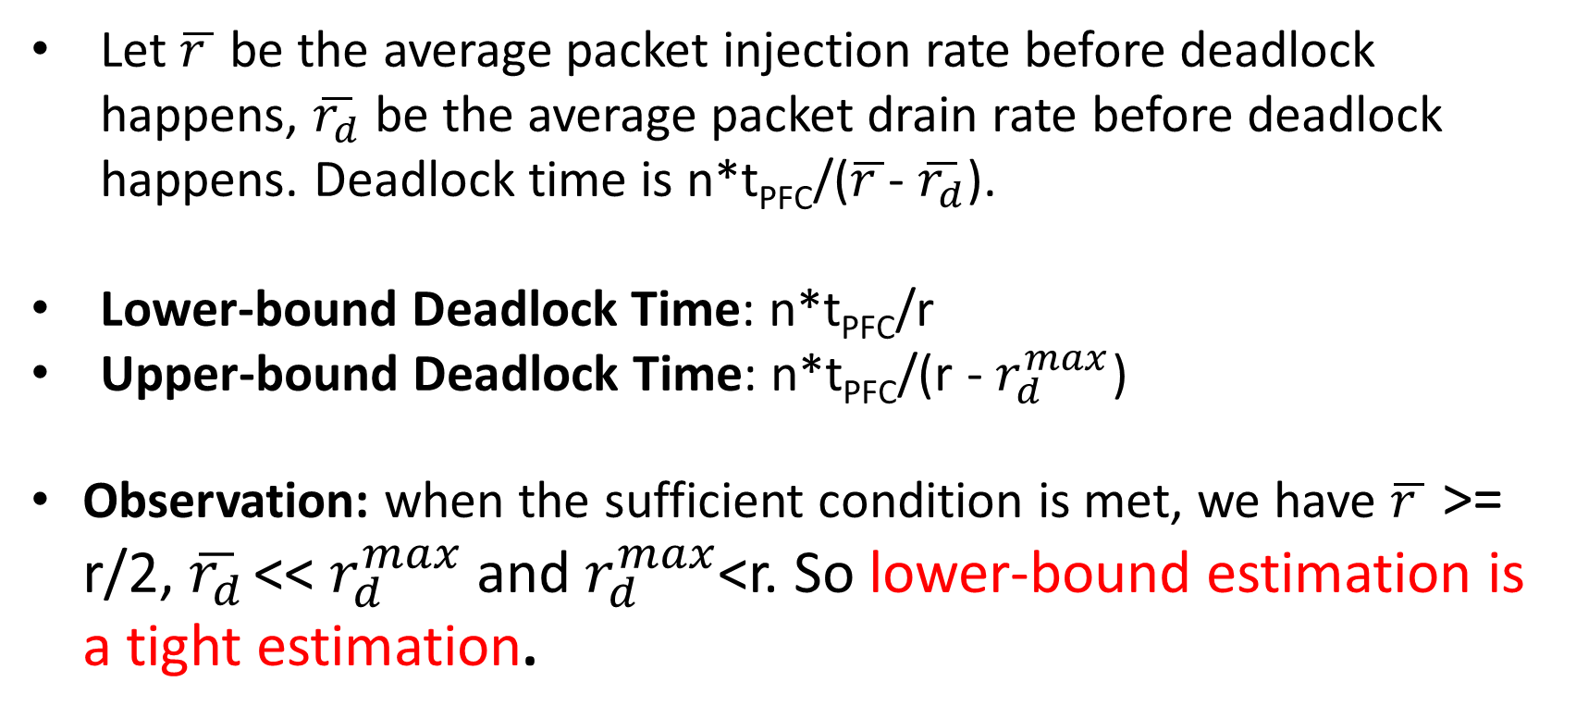
Loop-Induced Deadlock – Deadlock Time
Let $\overline{r }$ be the average packet injection rate before deadlock happens, $\overline{r_{d}}$ be the average packet drain rate before deadlock happens. Deadlock time is n*t_{PFC}/($\overline{r }$- $\overline{r_{d}}$).
Lower-bound Deadlock Time: n*t_{PFC}/r
Upper-bound Deadlock Time: n*t_{PFC}/($\text{r}$ - $r_{d}^{max}$)
Observation: when the sufficient condition is met, we have $\overline{r }$ >= r/2, $\overline{r_{d}}$ << $r_{d}^{max}$ and $r_{d}^{max}$<r. So lower-bound estimation is a tight estimation.

Slide 14
Analysis of Non-Loop Routing-Induced Deadlock

Slide 15
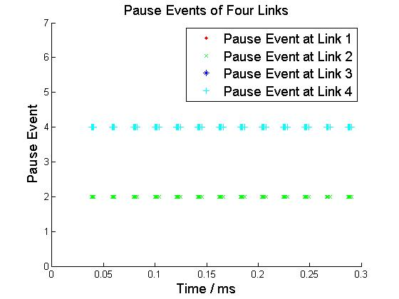

Deadlock Case 1 –
Cyclic Routing Dependency $≠$ Deadlock
S1
S2
Flow 1
tx
rx
rx
L1
tx
L4
L2
tx-1
L3
rx
S4
S3
Flow 2
tx-2
rx
tx
In this case, cyclic routing dependency is met but no deadlock.
Cyclic routing dependency is just a necessary condition as it is not guaranteed that all the links will be paused (Links L1 and L3 are not paused in this case).

Slide 16
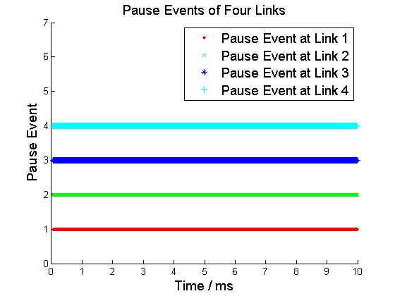
Deadlock Case 2 –
Adding One Flow can Create Deadlock
Flow 3
S1
S2
Flow 1
tx
rx
rx
L1
tx
L4
L2
tx-1
L3
rx
S4
S3
Flow 2
tx-2
rx
tx
Deadlock will happen in this case as all four links are paused and cannot be resumed.

Slide 17
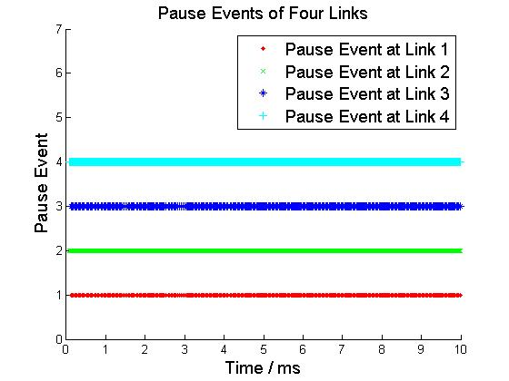

Deadlock Case 3 –
Simultaneous Pause $≠$ Deadlock
Flow 3
TX-2
rate limit=1/4
S1
S2
Flow 1
TX
RX 2
L1
TX-1
RX 1
L4
L2
L3
TX-1
RX 3
S4
RX 4
S3
Flow 2
TX
rate limit=1/4
TX-2
Flow 4
In this case, all the links in the cycle are paused at the same time but no deadlock.
Simultaneous Pause is just a necessary condition as it is not guaranteed that all the pauses will not be resumed (pause on L1 and L3 will be resumed in this case).

Slide 18
Deadlock Case 4
flow 2
rx
tx
S2
L1
L2
tx
L3
rx
flow 1
S1
S3
flow 3
rx
tx
Deadlock will happen in this case as all the three links are paused and cannot be resumed.

Slide 19
Deadlock Case 5 – In addition to Case 4,
Adding An Additional Switch Between S1 and S2
Flow 2
S4
S2
tx
rx
rx
L1
tx
L4
L2
L3
tx-1
rx
S1
S3
Flow 1
tx-2
rx
tx
Flow 3
Deadlock will still happen in this case after adding one additional switch.

Slide 20
Deadlock Case 6
Flow 2
Flow 1
S1
S2
tx
rx
rx
L1
tx
L4
L2
L3
tx-1
rx
S4
S3
tx-2
rx
tx
Flow 3
Flow 4
Deadlock will happen in this case as all the four links are paused and cannot be resumed.

Slide 21
Non-Loop Routing Induced Deadlock –
Deadlock Prediction
Deadlock Prediction is not a trivial thing. We cannot get a clear sufficient condition for deadlock prediction based on the previous 6 deadlock cases.
Two algorithms for deadlock prediction:
Non-lineal Fluid Model with Differential Equations (currently don’t know how to solve the differential equations)
Iterative Water-filling Algorithm (currently don’t know how to prove the correctness)

Slide 22
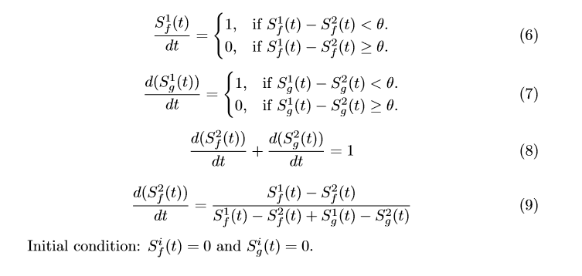
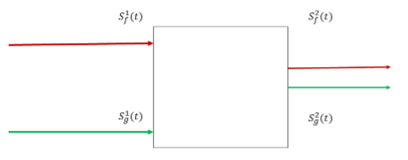
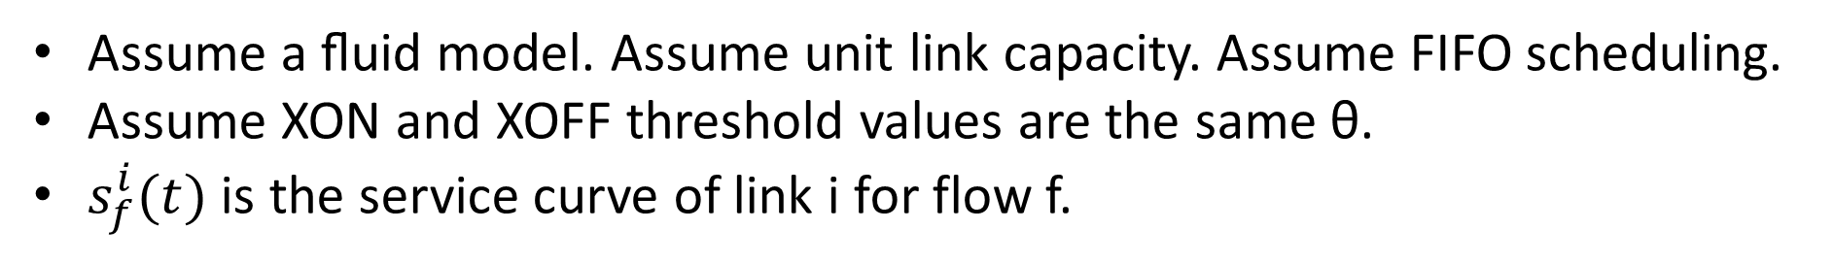
Non-lineal Fluid Model –
A simple example
Two Input ports and one output port.
Assume a ﬂuid model. Assume unit link capacity. Assume FIFO scheduling.
Assume XON and XOFF threshold values are the same θ.
$s_{f}^{i}(t)$ is the service curve of link i for flow f.

Slide 23
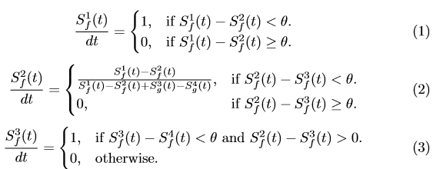
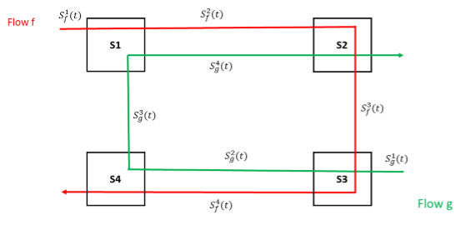
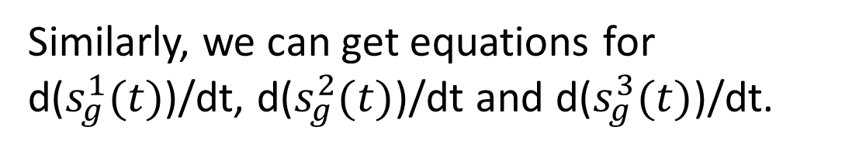
Non-lineal Fluid Model –
2-Flow 4-Switch Case (1)
Similarly, we can get equations for d($s_{g}^{1}(t)$)/dt, d($s_{g}^{2}(t)$)/dt and d($s_{g}^{3}(t)$)/dt.

Slide 24
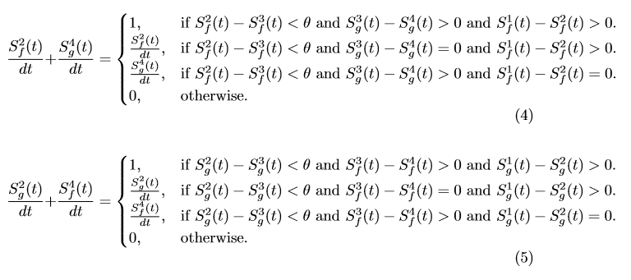
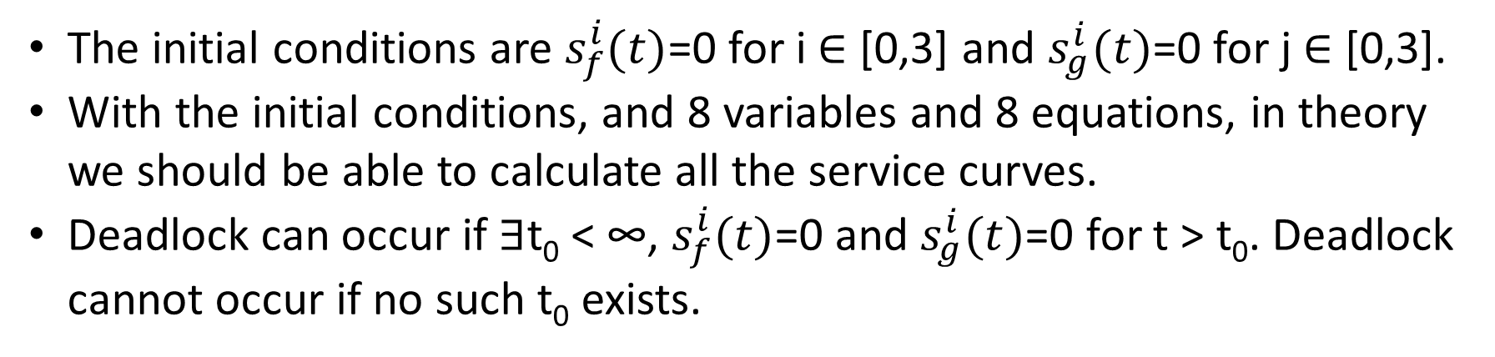
Non-lineal Fluid Model –
2-Flow 4-Switch Case (2)
The initial conditions are $s_{f}^{i}(t)$=0 for i ∈ [0,3] and $s_{g}^{i}(t)$=0 for j ∈ [0,3].
With the initial conditions, and 8 variables and 8 equations, in theory we should be able to calculate all the service curves.
Deadlock can occur if ∃t₀ < ∞, $s_{f}^{i}(t)$=0 and $s_{g}^{i}(t)$=0 for t > t₀. Deadlock cannot occur if no such t₀ exists.

Slide 25
Iterative Water-filling Algorithm -
Deﬁnition of Terms
Link dependency. An input link l_{j} depends on an output link l_{i} of switch S if a ﬂow is coming from l_{j} to l_{i}.
Pause-regulated link. A link is pause regulated if the destination of the link will send PAUSE frame with non-zero probability.
Pause-regulated ﬂow. We say a ﬂow fj is pause regulated at link li if li ∈ fj and its upstream link is pause-regulated.
At high level, this algorithm tries to resolve a set of ﬂow rates and pause probability, so that all ﬂow rates ﬁt into link capacity constraints.

Slide 26
Iterative Water-filling Algorithm -
Deﬁnition of Terms
Initial state: set the link capacity of all links to 1. Set the rate of all flows to 1 at all links.
Stage 1: Identify bottleneck links and compute max-min fair share rate.
Stage 2:
2.1 Identify pause-regulated link.
2.2 Compute the pause probability for all pause-regulated links.
2.3 Update ﬂow rates on dependent links (Considering backpressure of PFC).
Stage 3: Update effective capacity of all pause-regulated link (link capacity will decrease when PFC is taking effect).
Repeat Stages 1-3 until converge.

Slide 27
Some Solutions We Have Discussed
Per Ingress Queue Round-Robin Scheduling: when flows from different ingress queues are competing for the capacity of the same egress queue, its capacity will be shared in a round-robin way among all the ingress queues.
TTL-based Priority Scheduling: Assign higher priority to the packets with smaller TTL value. The intuition here is to pause the source of flows outside a routing cycle.
Distributed Time-out Based Detection and Recovery: if an egress queue is paused longer than a configured time-out value, the switch changes this queue into a lossy queue to break possible deadlocks.
Increase packet priority at bounding switch (more details in next page).

Slide 28
Solution for Preventing Deadlock in Clos Network
Core 1
Core 2
Priority = 2
Priority = 1
Aggr 1
Aggr 2
Aggr 3
Aggr 4
Priority = 1
Priority = 2
ToR 1
ToR 2
ToR 3
ToR 4
H1: 10.0.0.1
H2: 10.1.1.1
Key Idea: we increase the packet priority of a flow each time the flow changes its direction from DOWN to UP. We drop the packet when no higher priority is available.

Slide 29
Backup Slides

Slide 30
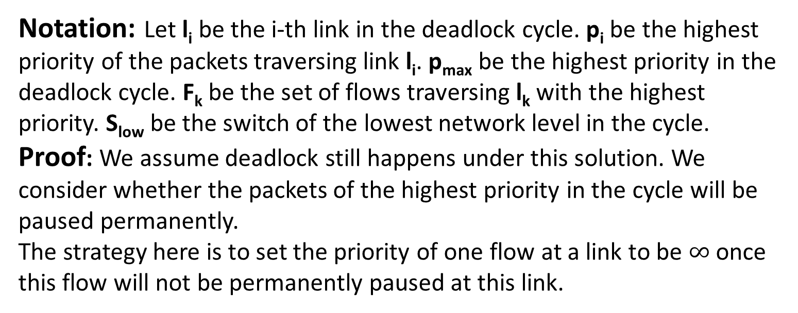
Solution for Preventing Deadlock in Clos Network
Highest Priority of l₁ = p₁
l₁
l₂
Highest Priority of l₂ = p₂
Highest Priority of l_{n} = p_{n}
l_{n}
l₃
Highest Priority of l₃ = p₃
…
Notation: Let l_{i} be the i-th link in the deadlock cycle. p_{i} be the highest priority of the packets traversing link l_{i}. p_{max} be the highest priority in the deadlock cycle. F_{k} be the set of flows traversing l_{k} with the highest priority. S_{low} be the switch of the lowest network level in the cycle.
Proof: We assume deadlock still happens under this solution. We consider whether the packets of the highest priority in the cycle will be paused permanently.
The strategy here is to set the priority of one flow at a link to be $∞$ once this flow will not be permanently paused at this link.

Slide 31
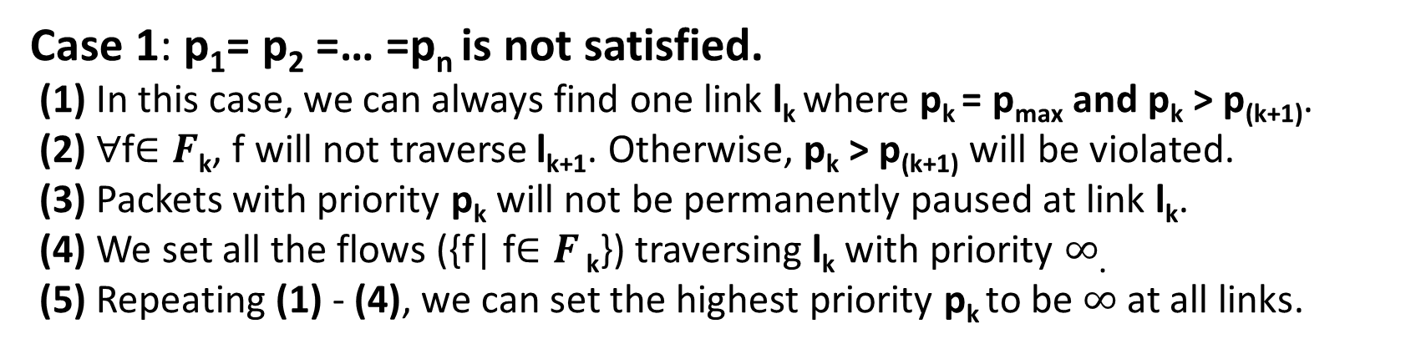
Solution for Preventing Deadlock in Clos Network
Notation | Description
l_{i} | the i-th link in the deadlock cycle
p_{max} | the highest priority in the deadlock cycle
p_{i} | the highest priority of the packets traversing link l_{i}
F_{k} | the set of flows traversing l_{k} with the highest priority p_{i}
l₁
l₂
…
l_{k+1}
…
l_{k}
p_{k} > p_{(k+1)}
Case 1: p₁= p₂ =… =p_{n} is not satisfied.
(1) In this case, we can always find one link l_{k} where p_{k} = p_{max} and p_{k} > p_{(k+1)}.
(2) ∀f$∈F\text{k}$, f will not traverse l_{k+1}. Otherwise, p_{k} > p_{(k+1)} will be violated.
(3) Packets with priority p_{k} will not be permanently paused at link l_{k}.
(4) We set all the flows ({f| f$∈F$ $\text{k}$}) traversing l_{k} with priority $∞$.
(5) Repeating (1) - (4), we can set the highest priority p_{k} to be $∞$at all links.

Slide 32
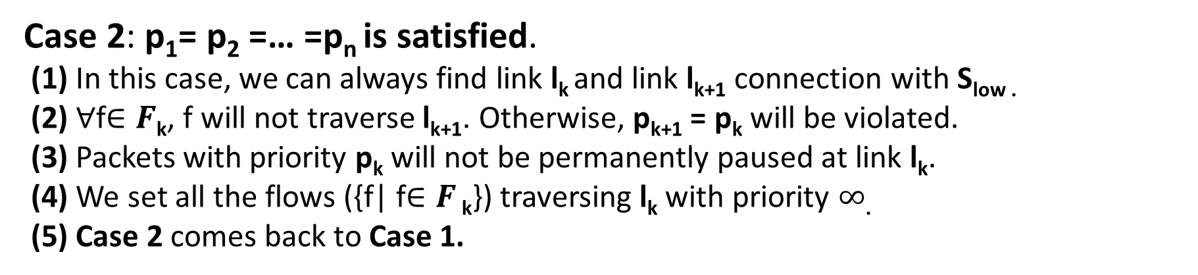
Solution for Preventing Deadlock in Clos Network
Notation | Description
l_{i} | the i-th link in the deadlock cycle
S_{low} | the switch of the lowest network level in the cycle.
p_{i} | the highest priority of the packets traversing link l_{i}
F_{k} | the set of flows traversing l_{k} with the highest priority p_{i}
l₁
l₂
…
l_{k+1}
…
l_{k}
S_{low}
f_{k}
Case 2: p₁= p₂ =… =p_{n} is satisfied.
(1) In this case, we can always find link l_{k} and link l_{k+1} connection with S_{low .}
(2) ∀f$∈F\text{k}$, f will not traverse l_{k+1}. Otherwise, p_{k+1} = p_{k} will be violated.
(3) Packets with priority p_{k} will not be permanently paused at link l_{k}.
(4) We set all the flows ({f| f$∈F$ $\text{k}$}) traversing l_{k} with priority $∞$.
(5) Case 2 comes back to Case 1.

Slide 33
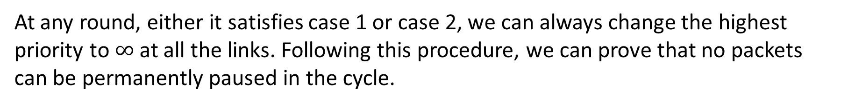
Solution for Preventing Deadlock in Clos Network
l₁
l₂
…
l_{k+1}
…
l_{k}
At any round, either it satisfies case 1 or case 2, we can always change the highest priority to $∞$at all the links. Following this procedure, we can prove that no packets can be permanently paused in the cycle.

Slide 34
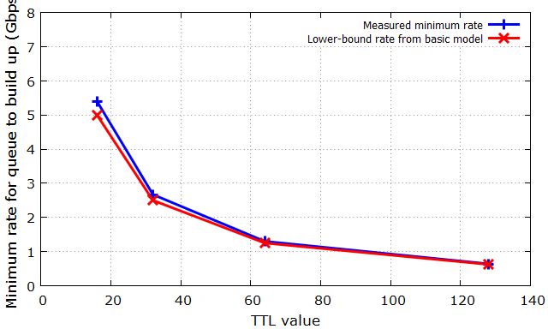
Verification of Basic Model – Exp A
We inject lossy UDP traffic into a 2-hop loop, and measure the minimum input rate at which queue will build up:
Observation: basic model provides a good lower-bound rate above which queue will build up.

Slide 35

Verification of Basic Model – Exp B
We inject lossless UDP traffic into a 2-hop loop, and measure the minimum input rate at which PFC deadlock will occur:
Observation: our basic model provides a good lower-bound input rate above which PFC deadlock will occur.

Slide 36
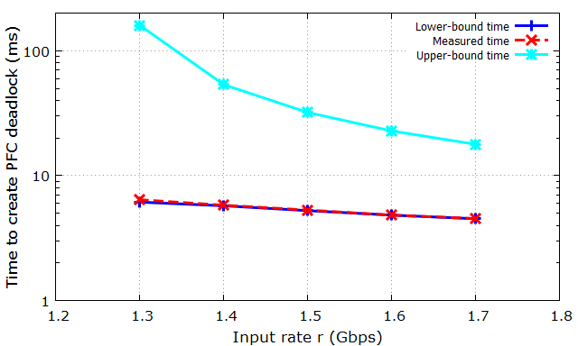
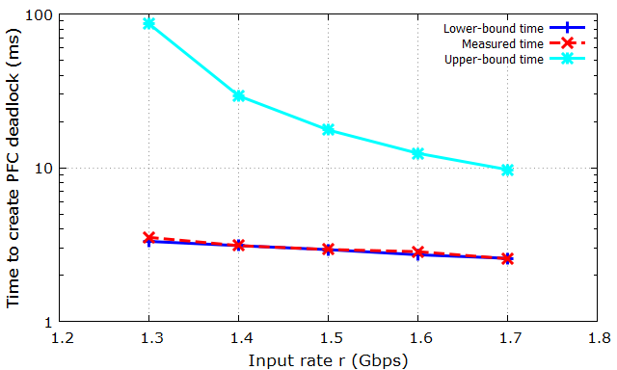
Verification of Estimation of Deadlock Time– Exp C
We inject lossless UDP traffic into a 2-hop loop, and measure the deadlock time:
(a) Setting: TTL = 64, α = 1/32 (no PFC deadlock when r < 1.3Gbps).
(b) Setting: TTL = 64, α = 1/64 (no PFC deadlock when r < 1.3Gbps).
Observation: Lower-bound estimation is a tight bound.

